Slide 1
SEQUENTIAL CIRCUIT
SR LATCH

Slide 2
Youtube
https://www.youtube.com/watch?v=B5Z04JRHccE&t=580s&pbjreload=101

Slide 3
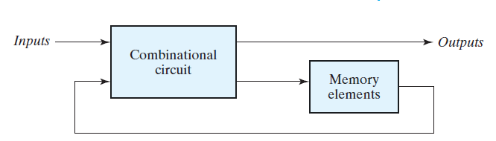
SEQUENTIAL CIRCUIT
Sequential circuit is a combination circuit with memory
Sequential circuit is specified by a time sequence of inputs, outputs, and internal states

Slide 4
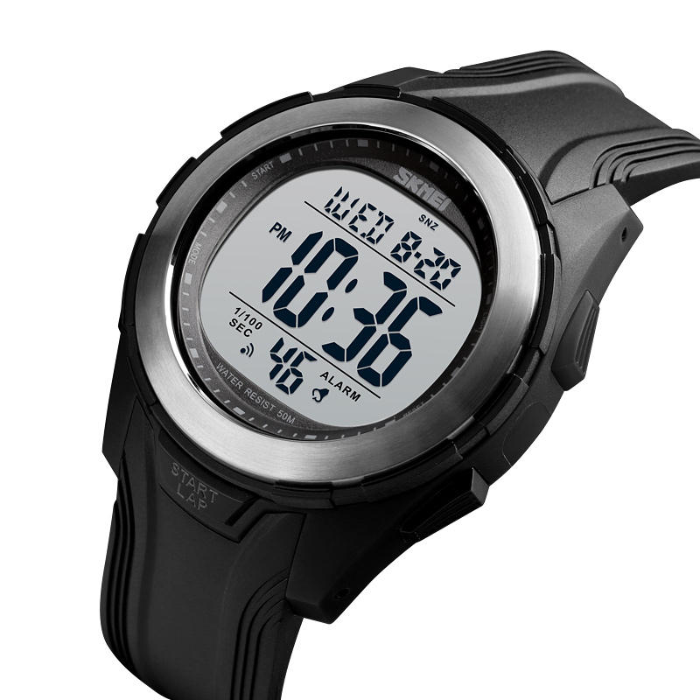
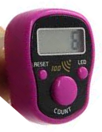

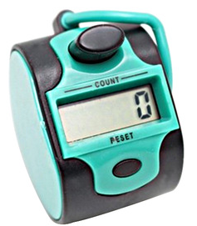
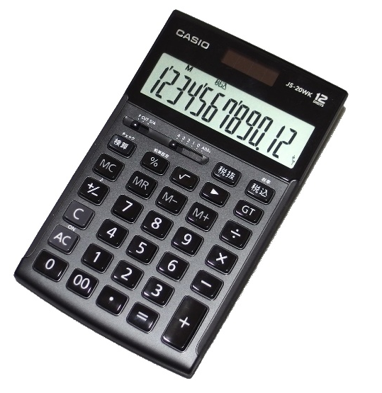
EXAMPLE SEQUENTIAL CIRCUIT

Slide 5
LATCH
Latch is a type of temporary storage device that has two stable states
Bistable
Multivibrator

Slide 6
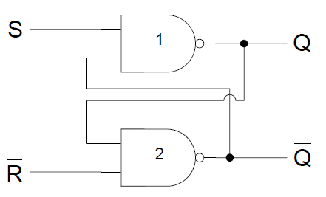
SR L ATCH

Slide 7
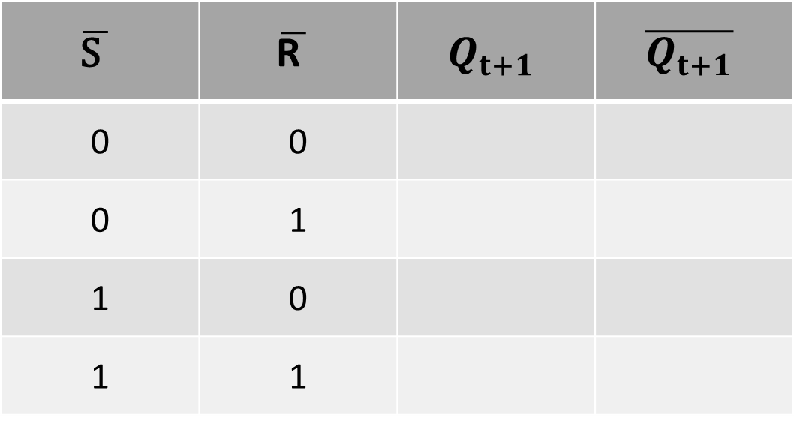
SR LATCH TABLE
$$\overline{\text{S} }$$ | $$\overline{\text{R} }$$ | $$Q_{t+1}$$ | $$\overline{Q_{t+1}}$$
0 | 0
0 | 1
1 | 0
1 | 1

Slide 8
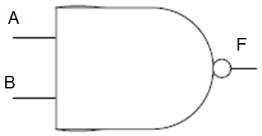
SR L ATCH
A | B | F
0 | 0 | 1
0 | 1 | 1
1 | 0 | 1
1 | 1 | 0

Slide 9
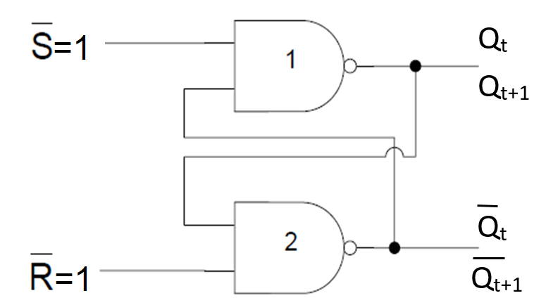
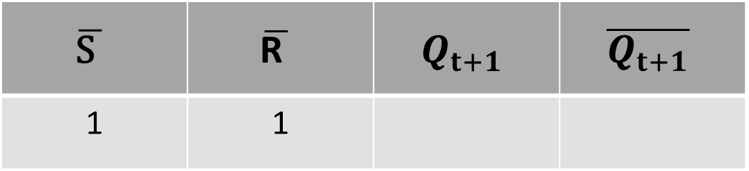
SR L ATCH
$$\overline{\text{S} }$$ | $$\overline{\text{R} }$$ | $$Q_{t+1}$$ | $$\overline{Q_{t+1}}$$
1 | 1

Slide 10
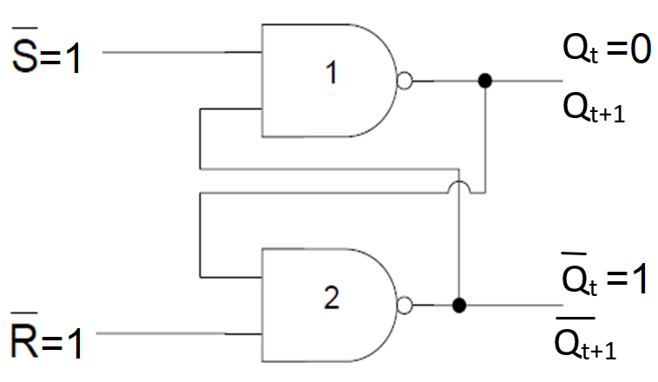
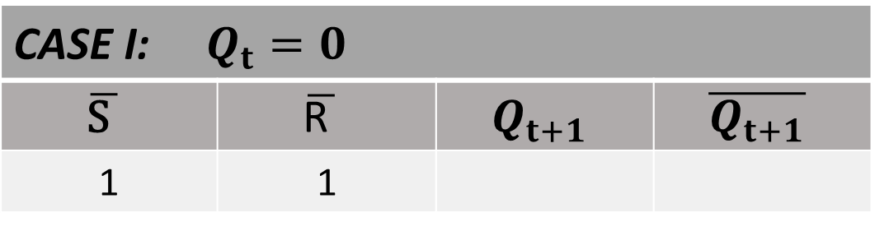
SR L ATCH
CASE I: $Q_{t}=0$
$$\overline{\text{S} }$$ | $$\overline{\text{R} }$$ | $$Q_{t+1}$$ | $$\overline{Q_{t+1}}$$
1 | 1

Slide 11
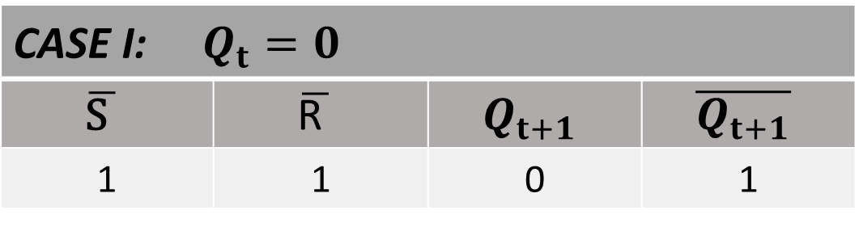
SR L ATCH
CASE I: $Q_{t}=0$
$$\overline{\text{S} }$$ | $$\overline{\text{R} }$$ | $$Q_{t+1}$$ | $$\overline{Q_{t+1}}$$
1 | 1 | 0 | 1

Slide 12
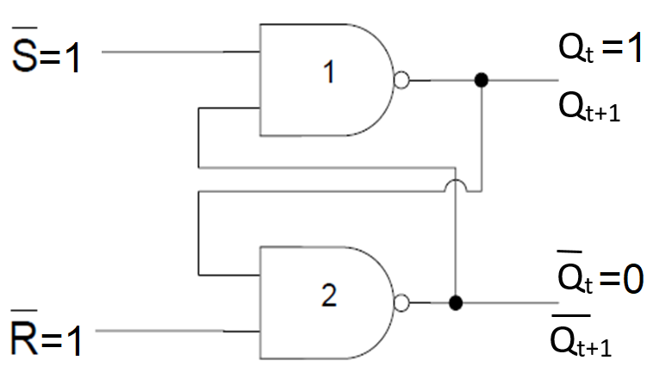
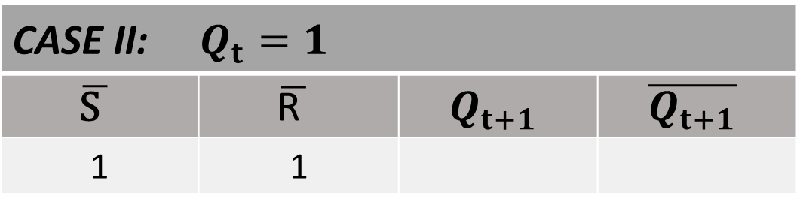
SR L ATCH
CASE II: $Q_{t}=1$
$$\overline{\text{S} }$$ | $$\overline{\text{R} }$$ | $$Q_{t+1}$$ | $$\overline{Q_{t+1}}$$
1 | 1

Slide 13
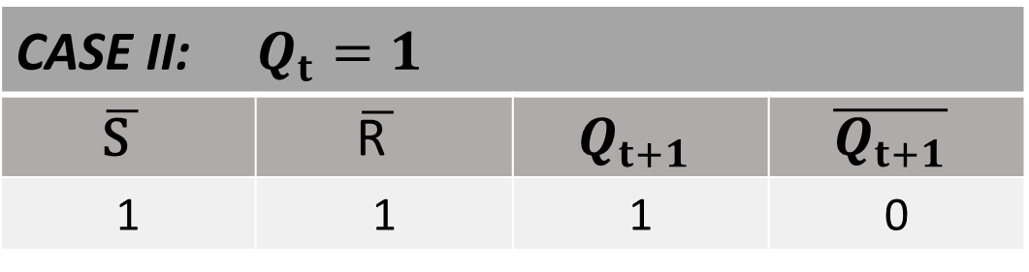
SR L ATCH
CASE II: $Q_{t}=1$
$$\overline{\text{S} }$$ | $$\overline{\text{R} }$$ | $$Q_{t+1}$$ | $$\overline{Q_{t+1}}$$
1 | 1 | 1 | 0

Slide 14
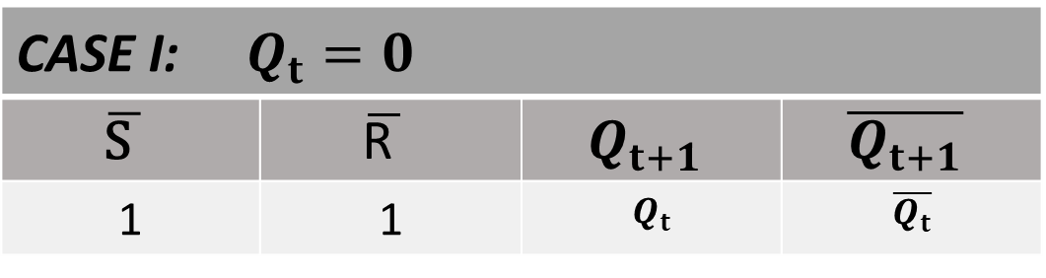
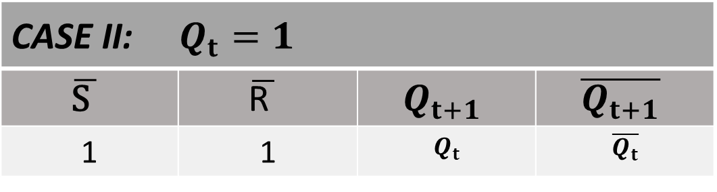
SR L ATCH
CASE I: $Q_{t}=0$
$$\overline{\text{S} }$$ | $$\overline{\text{R} }$$ | $$Q_{t+1}$$ | $$\overline{Q_{t+1}}$$
1 | 1 | $$Q_{t}$$ | $$\overline{Q_{t}}$$
CASE II: $Q_{t}=1$
$$\overline{\text{S} }$$ | $$\overline{\text{R} }$$ | $$Q_{t+1}$$ | $$\overline{Q_{t+1}}$$
1 | 1 | $$Q_{t}$$ | $$\overline{Q_{t}}$$

Slide 15
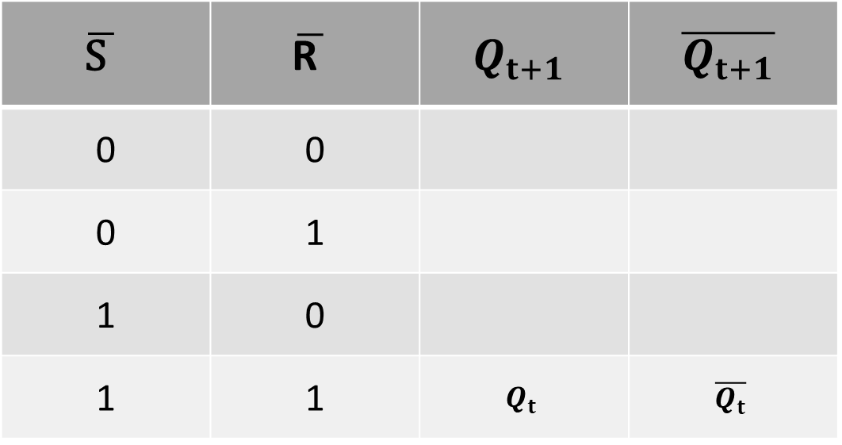
SR LATCH TABLE
$$\overline{\text{S} }$$ | $$\overline{\text{R} }$$ | $$Q_{t+1}$$ | $$\overline{Q_{t+1}}$$
0 | 0
0 | 1
1 | 0
1 | 1 | $$Q_{t}$$ | $$\overline{Q_{t}}$$

Slide 16
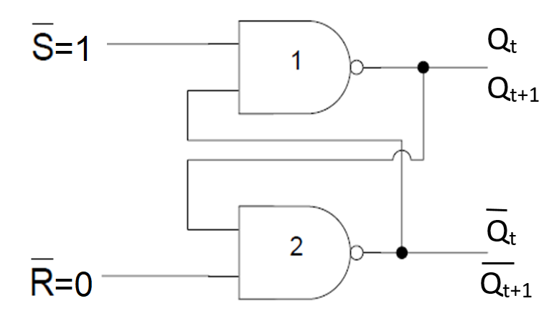
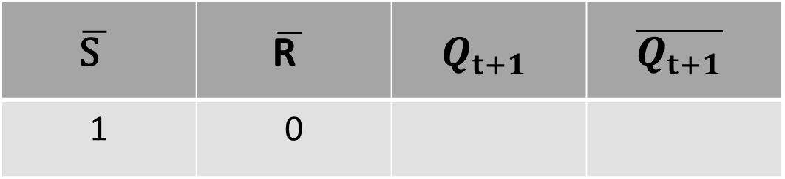
SR L ATCH
$$\overline{\text{S} }$$ | $$\overline{\text{R} }$$ | $$Q_{t+1}$$ | $$\overline{Q_{t+1}}$$
1 | 0

Slide 17
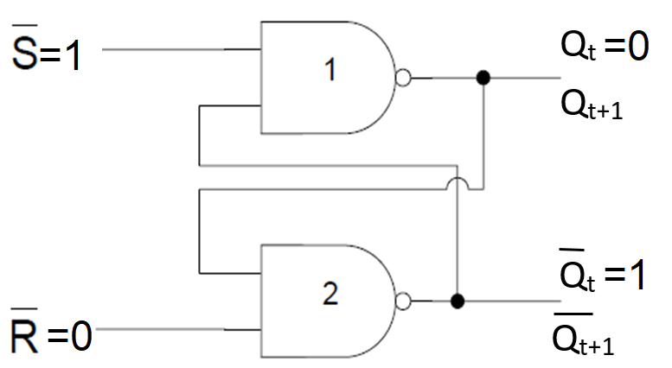

SR L ATCH
CASE I: $Q_{t}=0$
$$\overline{\text{S} }$$ | $$\overline{\text{R} }$$ | $$Q_{t+1}$$ | $$\overline{Q_{t+1}}$$
1 | 0

Slide 18

SR L ATCH
CASE I: $Q_{t}=0$
$$\overline{\text{S} }$$ | $$\overline{\text{R} }$$ | $$Q_{t+1}$$ | $$\overline{Q_{t+1}}$$
1 | 0 | 0 | 1

Slide 19
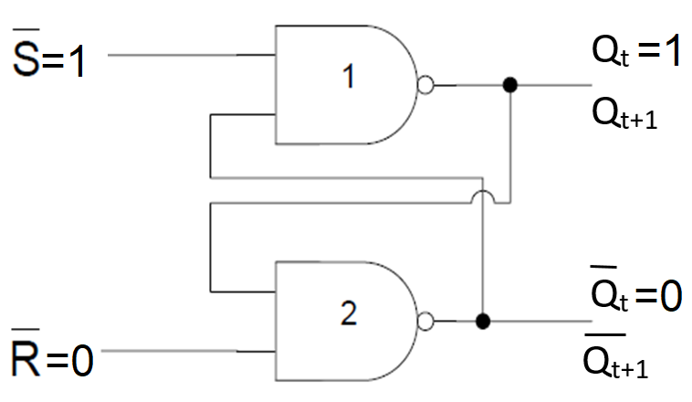
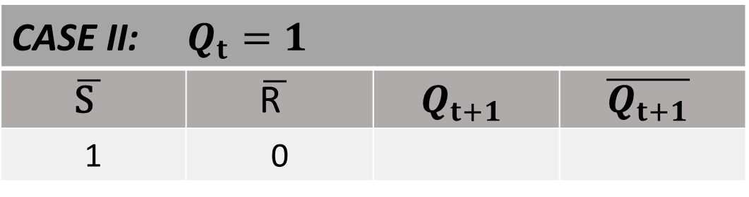
SR L ATCH
CASE II: $Q_{t}=1$
$$\overline{\text{S} }$$ | $$\overline{\text{R} }$$ | $$Q_{t+1}$$ | $$\overline{Q_{t+1}}$$
1 | 0

Slide 20
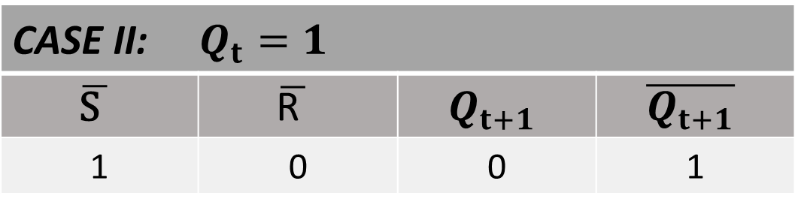
SR L ATCH
CASE II: $Q_{t}=1$
$$\overline{\text{S} }$$ | $$\overline{\text{R} }$$ | $$Q_{t+1}$$ | $$\overline{Q_{t+1}}$$
1 | 0 | 0 | 1

Slide 21

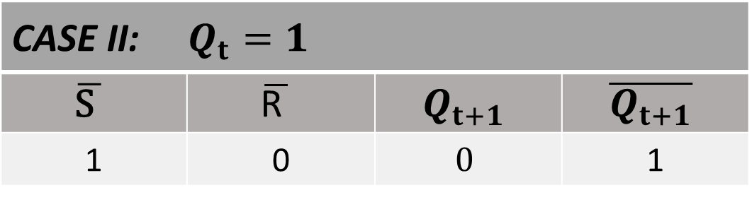
SR L ATCH
CASE I: $Q_{t}=0$
$$\overline{\text{S} }$$ | $$\overline{\text{R} }$$ | $$Q_{t+1}$$ | $$\overline{Q_{t+1}}$$
1 | 0 | 0 | 1
CASE II: $Q_{t}=1$
$$\overline{\text{S} }$$ | $$\overline{\text{R} }$$ | $$Q_{t+1}$$ | $$\overline{Q_{t+1}}$$
1 | 0 | $$0$$ | 1

Slide 22
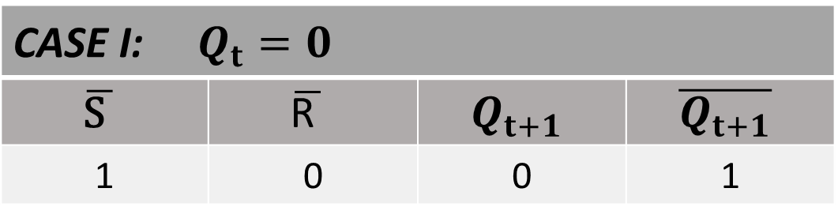
SR L ATCH
CASE I: $Q_{t}=0$
$$\overline{\text{S} }$$ | $$\overline{\text{R} }$$ | $$Q_{t+1}$$ | $$\overline{Q_{t+1}}$$
1 | 0 | 0 | 1
=
CASE II: $Q_{t}=1$
$$\overline{\text{S} }$$ | $$\overline{\text{R} }$$ | $$Q_{t+1}$$ | $$\overline{Q_{t+1}}$$
1 | 0 | $$0$$ | 1

Slide 23
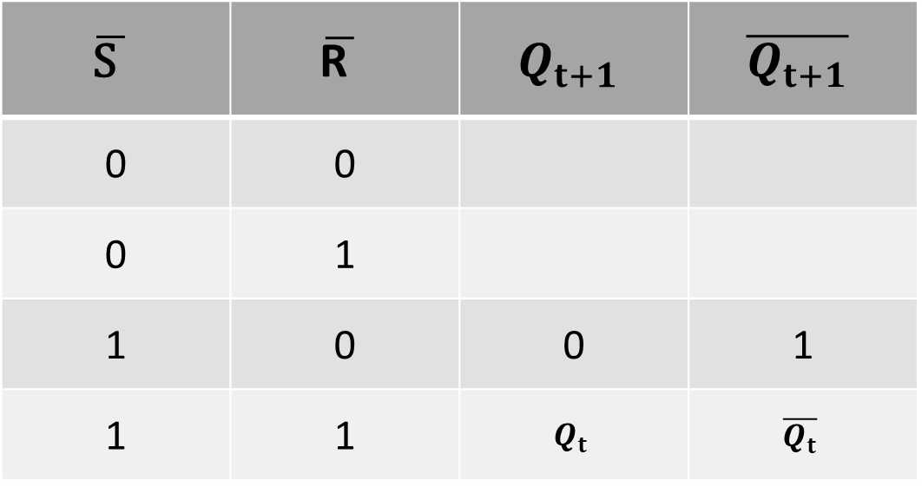
SR LATCH TABLE
$$\overline{\text{S} }$$ | $$\overline{\text{R} }$$ | $$Q_{t+1}$$ | $$\overline{Q_{t+1}}$$
0 | 0
0 | 1
1 | 0 | 0 | 1
1 | 1 | $$Q_{t}$$ | $$\overline{Q_{t}}$$

Slide 24
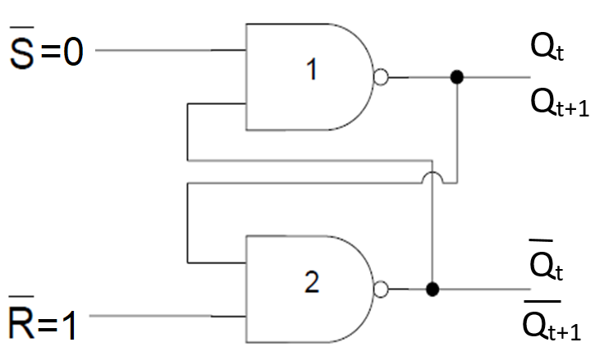
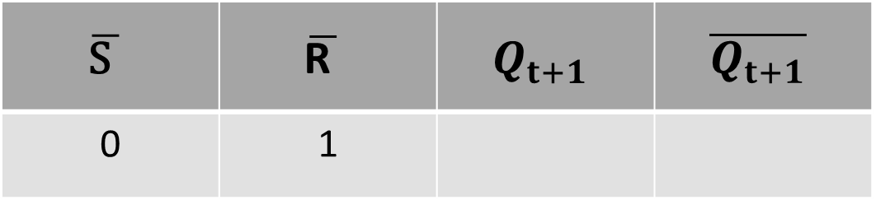
SR L ATCH
$$\overline{\text{S} }$$ | $$\overline{\text{R} }$$ | $$Q_{t+1}$$ | $$\overline{Q_{t+1}}$$
0 | 1

Slide 25
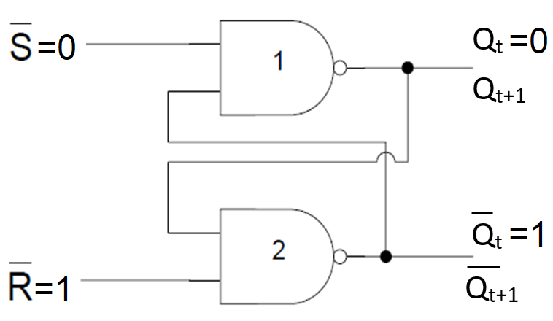

SR L ATCH
CASE I: $Q_{t}=0$
$$\overline{\text{S} }$$ | $$\overline{\text{R} }$$ | $$Q_{t+1}$$ | $$\overline{Q_{t+1}}$$
0 | 1

Slide 26
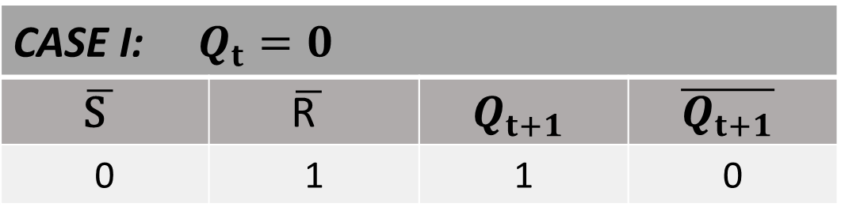
SR L ATCH
CASE I: $Q_{t}=0$
$$\overline{\text{S} }$$ | $$\overline{\text{R} }$$ | $$Q_{t+1}$$ | $$\overline{Q_{t+1}}$$
0 | 1 | 1 | 0

Slide 27
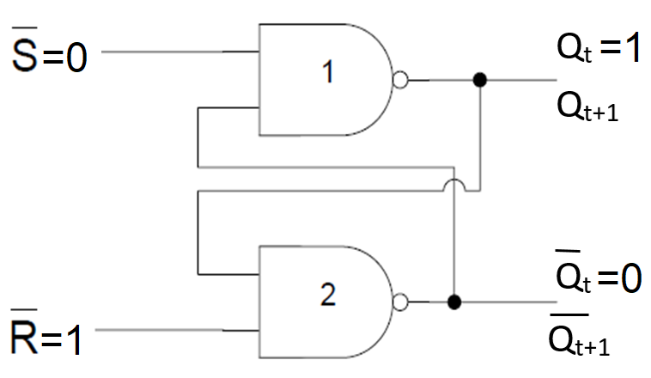
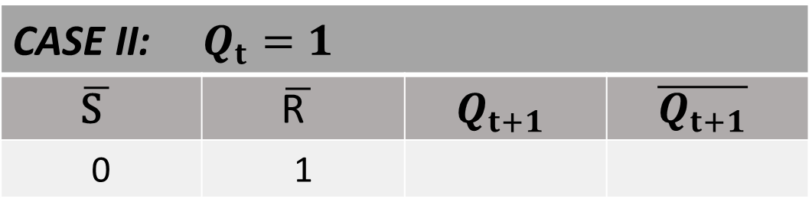
SR L ATCH
CASE II: $Q_{t}=1$
$$\overline{\text{S} }$$ | $$\overline{\text{R} }$$ | $$Q_{t+1}$$ | $$\overline{Q_{t+1}}$$
0 | 1

Slide 28
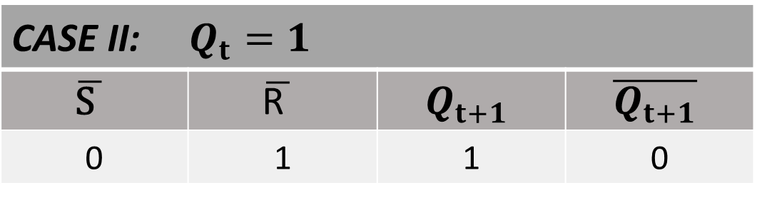
SR L ATCH
CASE II: $Q_{t}=1$
$$\overline{\text{S} }$$ | $$\overline{\text{R} }$$ | $$Q_{t+1}$$ | $$\overline{Q_{t+1}}$$
0 | 1 | 1 | 0

Slide 29

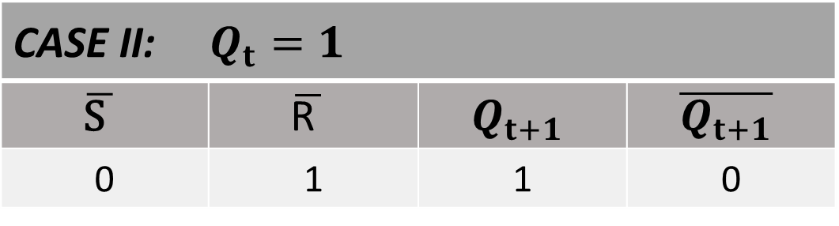
SR L ATCH
CASE I: $Q_{t}=0$
$$\overline{\text{S} }$$ | $$\overline{\text{R} }$$ | $$Q_{t+1}$$ | $$\overline{Q_{t+1}}$$
0 | 1 | 1 | 0
CASE II: $Q_{t}=1$
$$\overline{\text{S} }$$ | $$\overline{\text{R} }$$ | $$Q_{t+1}$$ | $$\overline{Q_{t+1}}$$
0 | 1 | 1 | 0

Slide 30
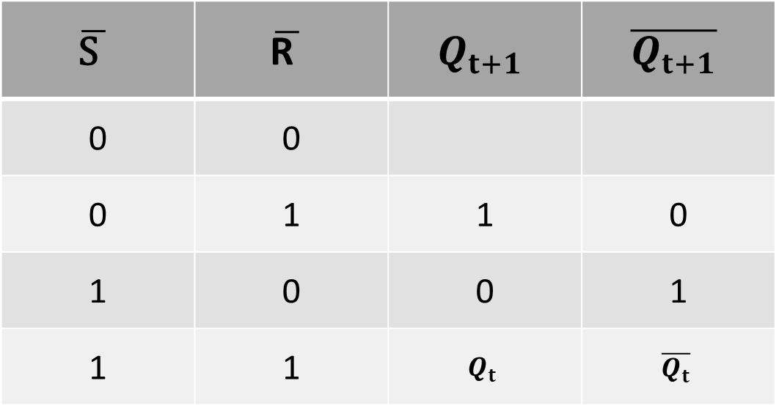
SR LATCH TABLE
$$\overline{\text{S} }$$ | $$\overline{\text{R} }$$ | $$Q_{t+1}$$ | $$\overline{Q_{t+1}}$$
0 | 0
0 | 1 | 1 | 0
1 | 0 | 0 | 1
1 | 1 | $$Q_{t}$$ | $$\overline{Q_{t}}$$

Slide 31
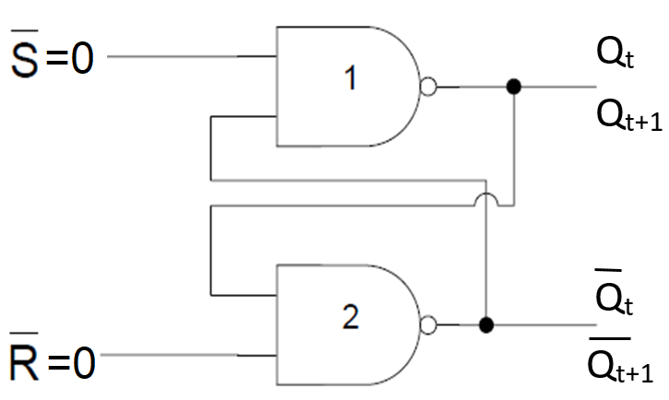

SR L ATCH
$$\overline{\text{S} }$$ | $$\overline{\text{R} }$$ | $$Q_{t+1}$$ | $$\overline{Q_{t+1}}$$
0 | 0

Slide 32
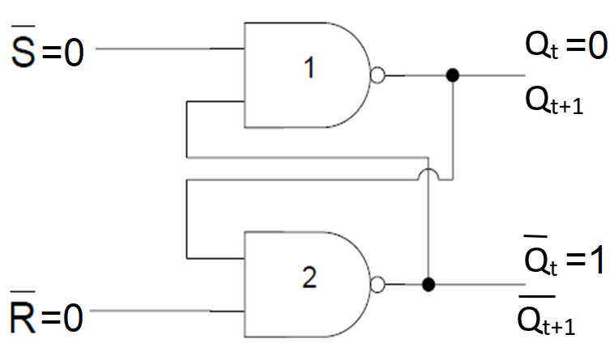

SR L ATCH
CASE I: $Q_{t}=0$
$$\overline{\text{S} }$$ | $$\overline{\text{R} }$$ | $$Q_{t+1}$$ | $$\overline{Q_{t+1}}$$
0 | 0

Slide 33
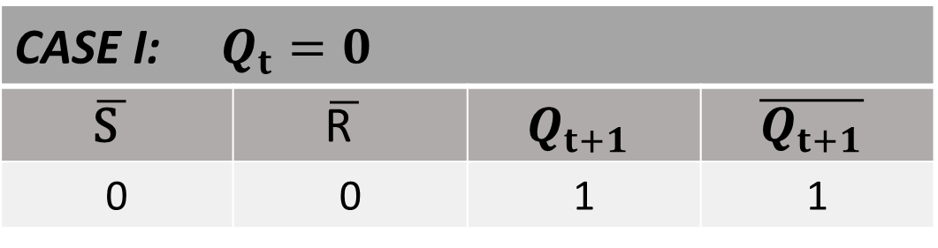
SR L ATCH
CASE I: $Q_{t}=0$
$$\overline{\text{S} }$$ | $$\overline{\text{R} }$$ | $$Q_{t+1}$$ | $$\overline{Q_{t+1}}$$
0 | 0 | 1 | 1

Slide 34
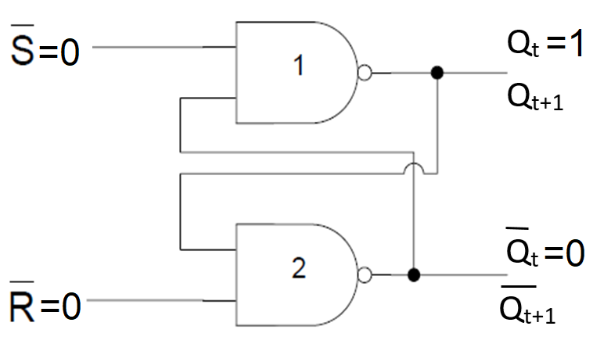
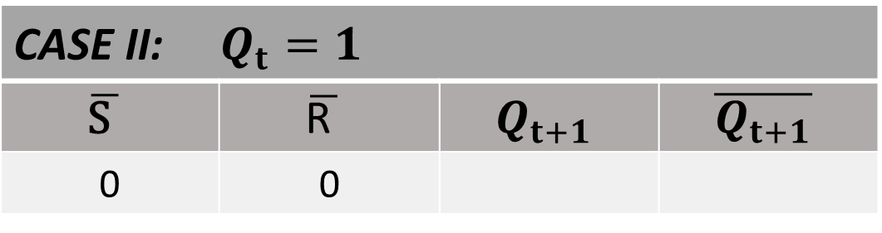
SR L ATCH
CASE II: $Q_{t}=1$
$$\overline{\text{S} }$$ | $$\overline{\text{R} }$$ | $$Q_{t+1}$$ | $$\overline{Q_{t+1}}$$
0 | 0

Slide 35
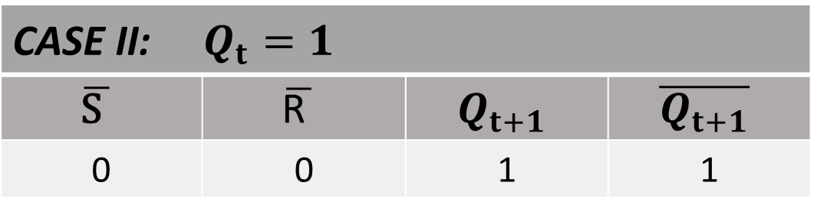
SR L ATCH
CASE II: $Q_{t}=1$
$$\overline{\text{S} }$$ | $$\overline{\text{R} }$$ | $$Q_{t+1}$$ | $$\overline{Q_{t+1}}$$
0 | 0 | 1 | 1

Slide 36

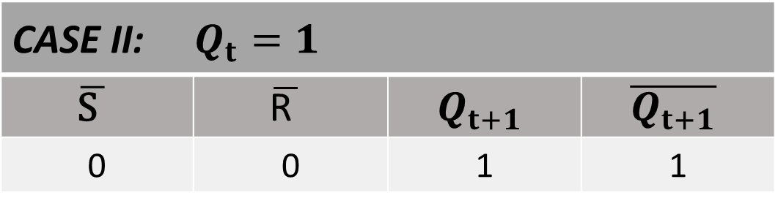
SR L ATCH
CASE I: $Q_{t}=0$
$$\overline{\text{S} }$$ | $$\overline{\text{R} }$$ | $$Q_{t+1}$$ | $$\overline{Q_{t+1}}$$
0 | 0 | 1 | 1
CASE II: $Q_{t}=1$
$$\overline{\text{S} }$$ | $$\overline{\text{R} }$$ | $$Q_{t+1}$$ | $$\overline{Q_{t+1}}$$
0 | 0 | 1 | 1

Slide 37
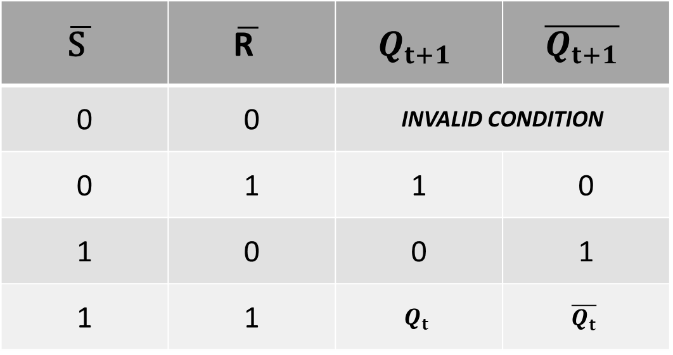
SR LATCH TABLE
$$\overline{\text{S} }$$ | $$\overline{\text{R} }$$ | $$Q_{t+1}$$ | $$\overline{Q_{t+1}}$$
0 | 0 | INVALID CONDITION
0 | 1 | 1 | 0
1 | 0 | 0 | 1
1 | 1 | $$Q_{t}$$ | $$\overline{Q_{t}}$$

Slide 38
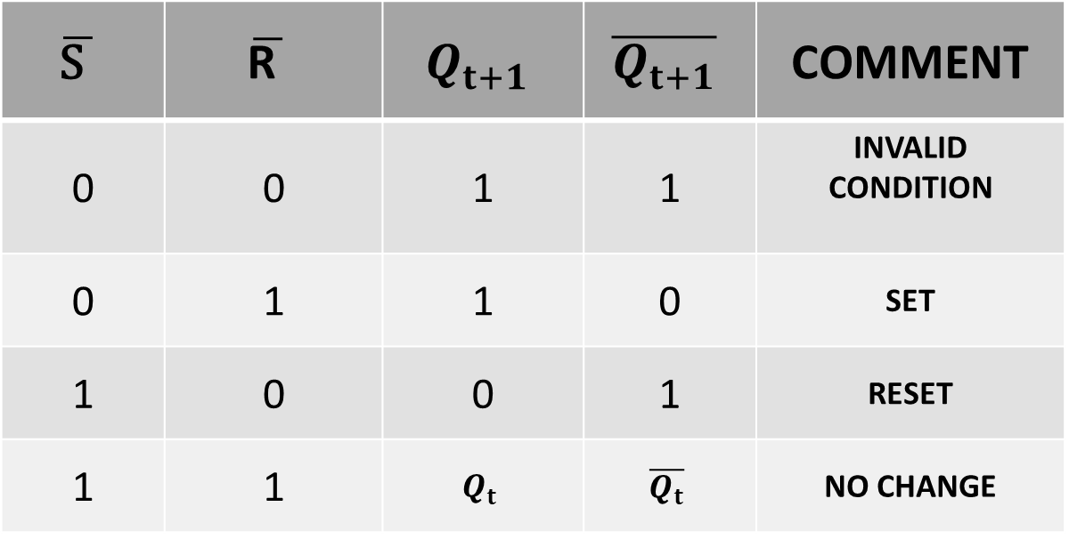
SR LATCH TABLE
$$\overline{\text{S} }$$ | $$\overline{\text{R} }$$ | $$Q_{t+1}$$ | $$\overline{Q_{t+1}}$$ | COMMENT
0 | 0 | 1 | 1 | INVALID CONDITION
0 | 1 | 1 | 0 | SET
1 | 0 | 0 | 1 | RESET
1 | 1 | $$Q_{t}$$ | $$\overline{Q_{t}}$$ | NO CHANGE

Slide 39
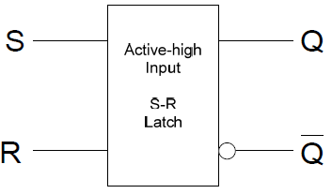
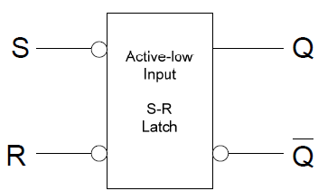
Logic Symbols

Slide 40
Logic Symbols

Slide 41
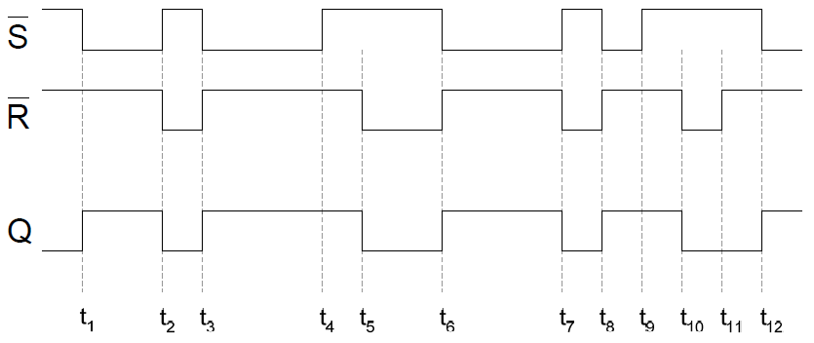
Timing diagrams

Slide 42
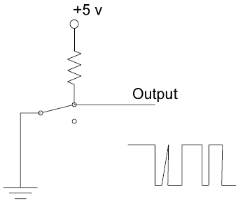


Latch Applications Switch ‘bounce’

Slide 43

Latch Applications: Burglar Alarm

